Slide 1
Arrhythmia Detection Deep Learning Signals
2022

Slide 2
Team Members
Ahmed Samir Afifi
Asmaa Shawqy wahba
Aya sherief Elasmar
Hekmat Gmal AbuElnnasr
Youmna Bahaa Eldean
Youmna Nabil Ahmed
2022

Slide 3
CONTENTS
Abstract
Introduction
01.
Brief
02.
abbreviations
Methods & Conclusion
03.
Problems Definition & solutions
04.
Conclusion
05.
Results

Slide 4
1
Abstract
Abstract:
An Electrocardiogram (ECG) is used as one of the important diagnostic tools for the detection of the health of a heart. An automatic heart abnormality identification methods sense numerous abnormalities or arrhythmia and decrease the physician’s pressure as well as share their work load. In ECG analysis, the main focus is to enhance degree of accuracy and include a number of heart diseases that can be classified.
In classification phase Deep Neural Network (DNN) classifier is used. This classifier categorizes the
normal and abnormal signals efficiently. The experimental analysis showed that, the Hybrid features Arrhythmia
classification performance of accuracy approximately 98.3%, Specificity 98.0% and Sensitivity 98.6% using MIT-BIH
database.
By using deep learning algorithm, which contains a set of codes, to calculate these numbers indicating the presence of a disease or not, and discovering Arrhythmia.

Slide 5
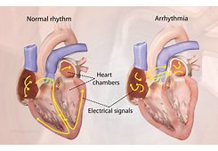
2
Introduction
Introduction:
In present days, the computerized ECG acquisition system plays an important role in monitoring and recording the signal in real time and
helps to recognize the normal and abnormal heart conditions. It is a non-invasive technique and used for the detection of a broad range of cardiac conditions like Arrhythmia, Heart rate variability, etc.
Earlier research works were based on ECG signals to improve the time complexity, decrease the high amount of information lost and reduce the cardiologist’s burden. To overcome these problems
computer based automated techniques are required for arrhythmia detection from large medical dataset
In some cases, medical specialist facing issues like, two signals have similar patterns, but show different diseases and in some other cases, two signals have different patterns but indicate the same disease.
In the past few decades, several methods for ECG analysis and heart disease detection have been developed to improve the heart abnormality classification. The ECG signals majorly include five
basic peaks such as P, Q, R and T peaks and Occasional U waves. The P peak indicates as atrial depolarization and T wave indicates the
repolarization of ventricle. The position of the QRS complex waveform is the significant section in the ECG signal research. The ECG signal is different for different persons similarly, different for the same person dissimilar kinds of heartbeats.

Slide 6
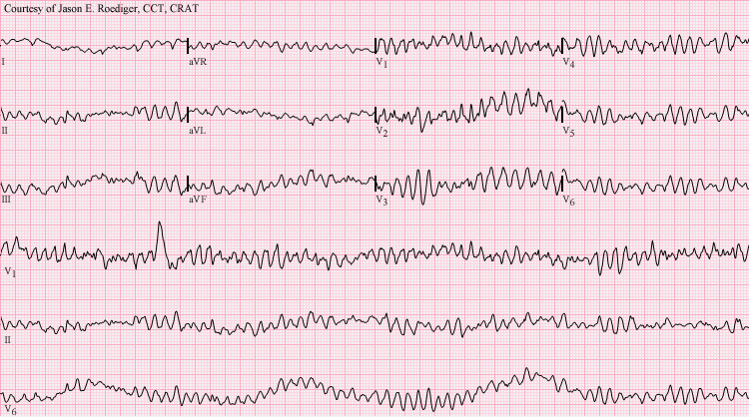
3
Problem Definition
Problem Definition
Arrhythmia is a chronic disease or condition characterized by an abnormal heart rhythm. This may lead to a fast heartbeat or a slow heartbeat.
And also known as an irregular heartbeat, a heart rate that is too fast — more than 100 beats per minute in adults — is called tachycardia, and a heart rate that is too slow — less than 60 beats per minute — is called bradycardia. Some types of arrhythmias have no symptoms. when present, may include palpitations or a feeling of stopping between heartbeats. In more serious cases, there may be dizziness, fainting, shortness of breath or chest pain but others may lead to sudden death.
Can detect this by using ECG signals devices.
The Figure below shown that the arrhythmia signals.

Slide 7
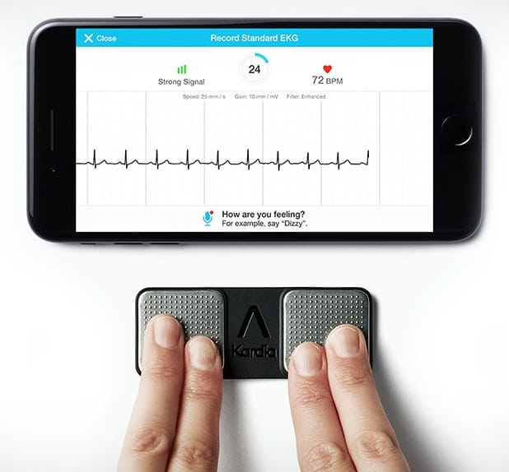
4
Solutions
The solution is to detect these diseases using APPs contains artificial intelligence model for deep learning that detects cardiac signals.
These signs can be classified and know if the person is sick or not
When the heartbeat is measured and captured by ECG Devices
There are several lasers used to produce information capable of automatic detection of these diseases
Or the presence of an application among the applications that has an artificial intelligence model that automatically detects these signals as well.

Slide 8
5
Methods
Algorithm was chosen that detects arrhythmia disease
This is in several steps:
Including choosing a dataset in order to obtain cardiac signals and filter them from noise signals.
And then these signals are processed by a deep learning model that helps in solving this problem and discovering the disease.
Then the areas with signs of the pathogen are identified
And determine the features selection for them
Then this data is entered into a deep learning model to train on this data and these signals.
And then the model is classified as this disease, whether it is arrhythmia or not.
Is the patient normal or not.

Slide 9

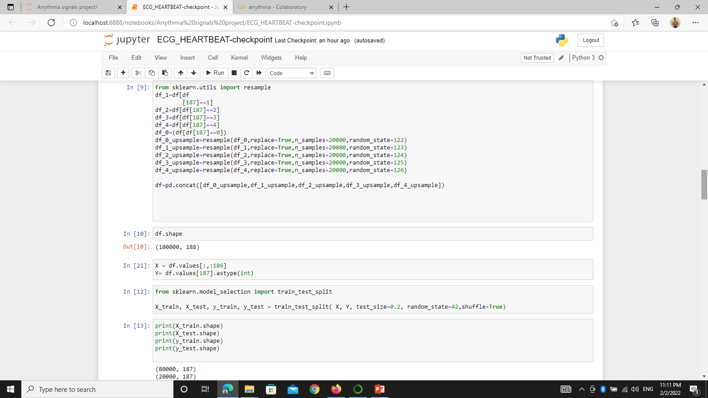
6
Classification
After the extraction of features from pre-processed data, the ECG data are used for predicting the abnormal and normal signal. The classification is used DNN, which produce compositional models where the object is expressed as a layered composition of primitives. The DNN, minimize the cross entropy or noise between the actual and predicted outcomes. This usually involves neural layers learning on huge dataset. An additional layer allows configurations of lower layer features constructing complex data hypothetically.
And display this by normal or abnormal by annotations.

Slide 10
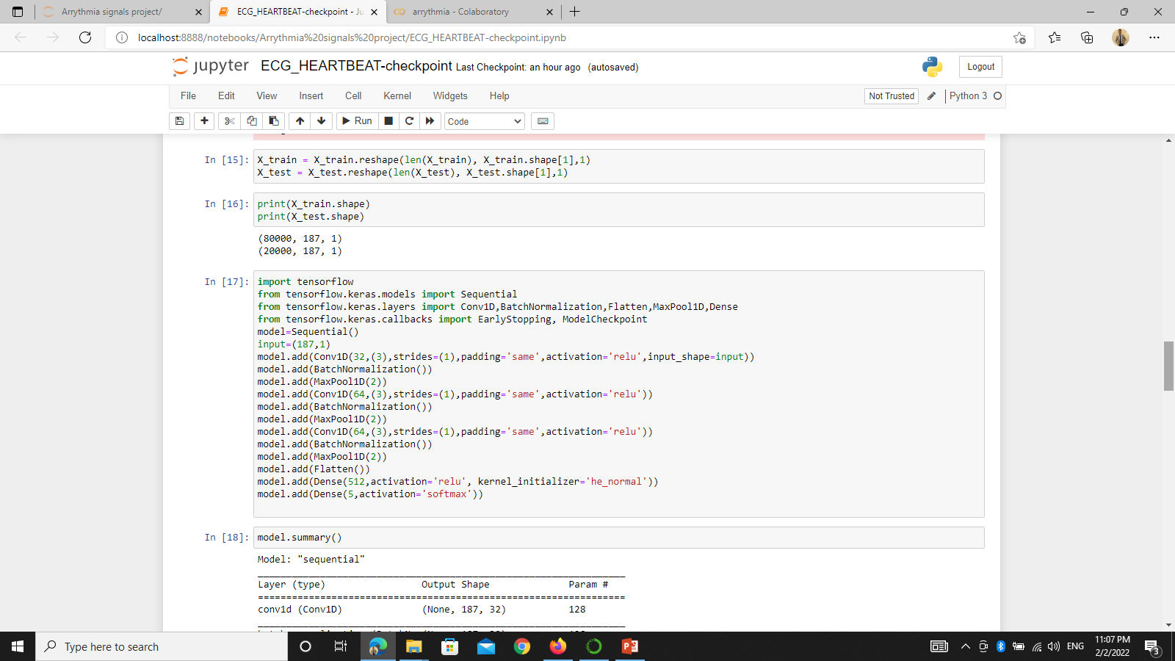
7
Deep neural network
The DNNs typically working like feed forward networks. Here, the data flow from the input layer to the output layer with no looping back. The major advantage of DNN classifier as, during classification, the possibilities of missing some signals in this situation the classifier automatically takes the signal and used to further process.

Slide 11
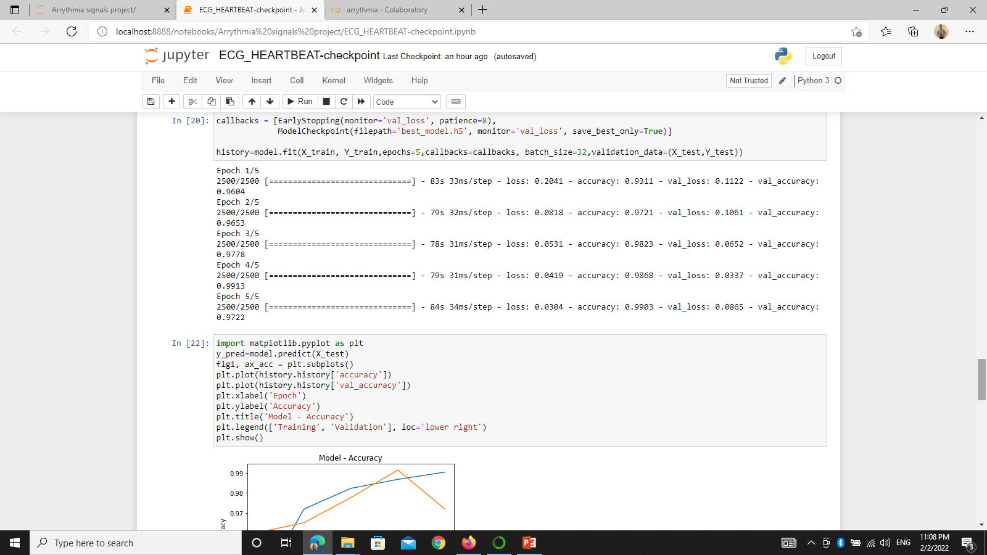
8
Experimental result and discussion
In this section, the experimental results have been described in detailed. The experiments were implemented on Google Colab.
trained by using DNN of ECG signal from MIT-BIH database. This dataset consists of 48 half-hour extracts of two channel ambulatory ECG recordings, obtained from 47 subjects studied by the BIH Arrhythmia Laboratory. But in this study, two sets of signals are taken such that 18 normal signals and 18 abnormal signals, so total 36 signals are taken in same training and testing cases. The hybrid feature identifies the ECG signal using the normal signal or SNR and abnormal signal or Arrhythmia. The performance evaluation of the proposed system is described in below section.
The DNN utilizes the unsupervised pre-training technique with greedy layer wise training, starting from the input layer to the soft max layer.
Accuracy = 99.44% and validation accuracy = 80.35% the final results.

Slide 12
THANKS
For Your Watching
BENHA UNIVERSITY

